Slide 1

SiMSCI Futures and STI ETF Arbitrage
Group :Peng Shaohua, Guo Xiangshuai, Xu Wei, Minh Nguyen

Slide 2
The problem – Market Inefficiency Problem
Singapore MSCI Futures
STI ETF

Slide 3
Singapore MSCI Futures
What they aim:
Aims to meet the trading and hedging needs of investors who have exposure to large and mid-cap companies
What they do:
Designed to measure the performance of the large and mid cap segments of the Singapore market
Uses foreign prices instead of local prices when available.

Slide 4
The Index composition
Singapore MSCI Futures
STI ETF
Name | Price | Shares | Weight%
ASCENDAS REIT | 2.85 | 3214849721 | 3.86%
CAPITALAND | 3.28 | 2638495841 | 3.65%
CAPITALAND INTEGRATED | 2.1 | 4529492881 | 4.01%
CITY DEVELOPMENTS | 7.6 | 454650500 | 1.46%
DBS GROUP HOLDINGS | 28.85 | 1796284457 | 21.85%
GENTING SINGAPORE | 0.865 | 6047013412 | 2.21%
KEPPEL CORP | 5.24 | 1456446214 | 3.22%
MAPLETREE COMM TRUST | 2.01 | 2154820862 | 1.83%
MAPLETREE LOGISTICS | 1.78 | 2892704287 | 2.17%
OCBC BANK | 11.8 | 3357070601 | 16.7%
SINGAPORE AIRLINES | 5.31 | 1339894577 | 3%
SINGAPORE EXCHANGE | 9.92 | 803731800 | 3.36%
SINGAPORE TECH ENGR | 3.88 | 1561247599 | 2.55%
SINGAPORE TELECOM | 2.37 | 8164579150 | 8.16%
SUNTEC REIT | 1.52 | 1977706058 | 1.27%
UNITED OVERSEAS BANK | 25.7 | 1178741101 | 12.77%
UNITED OVERSEAS LAND | 7.41 | 464054927.6 | 1.45%
VENTURE CORP | 19.1 | 276417298.2 | 2.23%
WILMAR INTERNATIONAL | 5.26 | 1921020332 | 4.26%
Name | Price | Shares | Weight%
SINGAPORETECH ENGINEERING | 3.86 | 7894 | 1.97%
DBS GROUPHOLDINGS LTD | 28.31 | 9242 | 16.89%
DAIRY FARMINTL HLDGS LTD | 6.270264 | 1555 | 0.63%
CITY DEVELOPMENTS LTD | 7.53 | 2423 | 1.18%
JARDINE CYCLE + CARRIAGE LTD | 23.04 | 512 | 0.76%
SATS LTD | 4.38 | 3282 | 0.93%
SINGAPOREEXCHANGE LTD | 10.15 | 4249 | 2.78%
CAPITALANDLTD | 3.24 | 13314 | 2.78%
CAPITALANDINTEGRATED COMMER | 2.12 | 22568 | 3.09%
HONGKONG LAND HOLDINGS LTD | 7.047349 | 5998 | 2.73%
JARDINE MATHESON HLDGS LTD | 87.85069 | 1085 | 6.15%
JARDINE STRATEGIC HLDGS LTD | 44.02583 | 939 | 2.67%
ASCENDAS REAL ESTATE INV TRT | 2.9 | 16886 | 3.16%
COMFORTDELGRO CORP LTD | 1.69 | 10615 | 1.16%
SINGAPOREAIRLINES LTD | 5.32 | 6595 | 2.26%
UNITED OVERSEAS BANK LTD | 25.35 | 6649 | 10.88%
UOL GROUPLTD | 7.44 | 2547 | 1.22%
VENTURE CORP LTD | 19.14 | 1345 | 1.66%
GENTING SINGAPORE LTD | 0.9 | 29974 | 1.74%
MAPLETREEINDUSTRIAL TRUST | 2.56 | 8465 | 1.40%
MAPLETREECOMMERCIAL TRUST | 2.05 | 11326 | 1.50%
KEPPEL DCREIT | 2.58 | 6276 | 1.05%
SINGAPORETELECOMMUNICATIONS | 2.36 | 38495 | 5.86%
SEMBCORP INDUSTRIES LTD | 1.81 | 4700 | 0.55%
MAPLETREELOGISTICS TRUST | 1.8 | 14321 | 1.66%
OVERSEA CHINESE BANKING CORP | 11.75 | 18096 | 13.72%
THAI BEVERAGE PCL | 0.76 | 50740 | 2.49%
WILMAR INTERNATIONAL LTD | 5.37 | 10971 | 3.80%
KEPPEL CORP LTD | 5.24 | 7422 | 2.51%
YANGZIJIANG SHIPBUILDING | 1.17 | 10866 | 0.82%
Source: MCSI

Slide 5
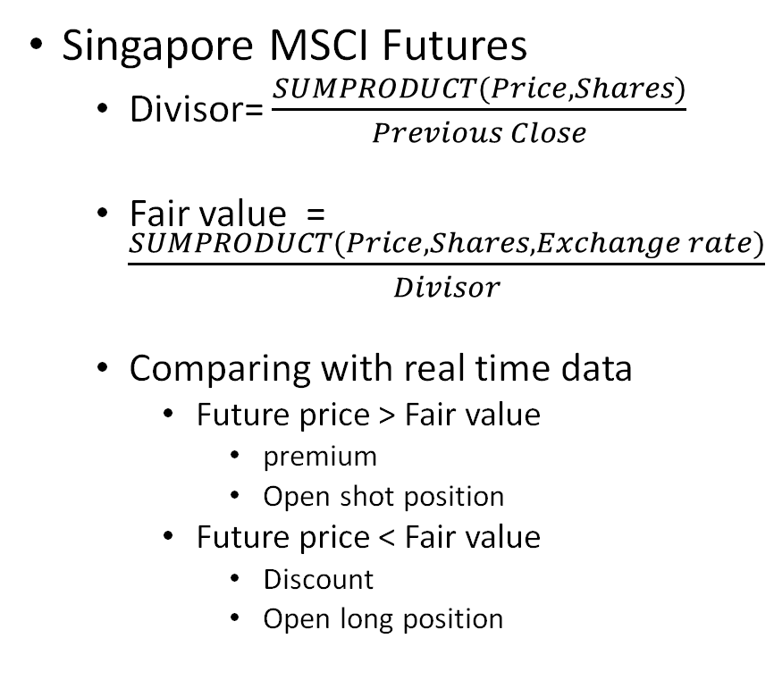
Fair Value calculation – MSCI Futures
Singapore MSCI Futures
Divisor= $\frac{SUMPRODUCT(Price,Shares)}{Previous Close}$
Fair value = $\frac{SUMPRODUCT(Price,Shares,Exchange rate)}{Divisor}$
Comparing with real time data
Future price > Fair value
premium
Open shot position
Future price < Fair value
Discount
Open long position
Name | Price | Shares | Weight%
ASCENDAS REIT | 2.85 | 3214849721 | 3.86%
CAPITALAND | 3.28 | 2638495841 | 3.65%
CAPITALAND INTEGRATED | 2.1 | 4529492881 | 4.01%
CITY DEVELOPMENTS | 7.6 | 454650500 | 1.46%
DBS GROUP HOLDINGS | 28.85 | 1796284457 | 21.85%
GENTING SINGAPORE | 0.865 | 6047013412 | 2.21%
KEPPEL CORP | 5.24 | 1456446214 | 3.22%
MAPLETREE COMM TRUST | 2.01 | 2154820862 | 1.83%
MAPLETREE LOGISTICS | 1.78 | 2892704287 | 2.17%
OCBC BANK | 11.8 | 3357070601 | 16.7%
SINGAPORE AIRLINES | 5.31 | 1339894577 | 3%
SINGAPORE EXCHANGE | 9.92 | 803731800 | 3.36%
SINGAPORE TECH ENGR | 3.88 | 1561247599 | 2.55%
SINGAPORE TELECOM | 2.37 | 8164579150 | 8.16%
SUNTEC REIT | 1.52 | 1977706058 | 1.27%
UNITED OVERSEAS BANK | 25.7 | 1178741101 | 12.77%
UNITED OVERSEAS LAND | 7.41 | 464054927.6 | 1.45%
VENTURE CORP | 19.1 | 276417298.2 | 2.23%
WILMAR INTERNATIONAL | 5.26 | 1921020332 | 4.26%

Slide 6
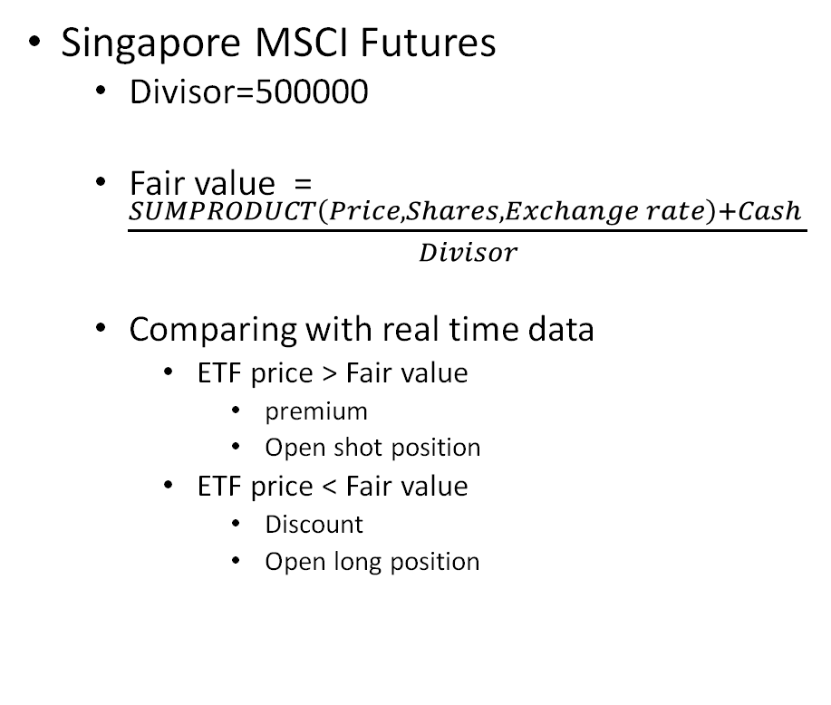
Fair Value calculation – STI ETF
Singapore MSCI Futures
Divisor=500000
Fair value = $\frac{SUMPRODUCT\left(Price,Shares,Exchange rate\right)+Cash }{Divisor}$
Comparing with real time data
ETF price > Fair value
premium
Open shot position
ETF price < Fair value
Discount
Open long position
Name | Price | Shares | Weight%
SINGAPORETECH ENGINEERING | 3.86 | 7894 | 1.97%
DBS GROUPHOLDINGS LTD | 28.31 | 9242 | 16.89%
DAIRY FARMINTL HLDGS LTD | 6.270264 | 1555 | 0.63%
CITY DEVELOPMENTS LTD | 7.53 | 2423 | 1.18%
JARDINE CYCLE + CARRIAGE LTD | 23.04 | 512 | 0.76%
SATS LTD | 4.38 | 3282 | 0.93%
SINGAPOREEXCHANGE LTD | 10.15 | 4249 | 2.78%
CAPITALANDLTD | 3.24 | 13314 | 2.78%
CAPITALANDINTEGRATED COMMER | 2.12 | 22568 | 3.09%
HONGKONG LAND HOLDINGS LTD | 7.047349 | 5998 | 2.73%
JARDINE MATHESON HLDGS LTD | 87.85069 | 1085 | 6.15%
JARDINE STRATEGIC HLDGS LTD | 44.02583 | 939 | 2.67%
ASCENDAS REAL ESTATE INV TRT | 2.9 | 16886 | 3.16%
COMFORTDELGRO CORP LTD | 1.69 | 10615 | 1.16%
SINGAPOREAIRLINES LTD | 5.32 | 6595 | 2.26%
UNITED OVERSEAS BANK LTD | 25.35 | 6649 | 10.88%
UOL GROUPLTD | 7.44 | 2547 | 1.22%
VENTURE CORP LTD | 19.14 | 1345 | 1.66%
GENTING SINGAPORE LTD | 0.9 | 29974 | 1.74%
MAPLETREEINDUSTRIAL TRUST | 2.56 | 8465 | 1.40%
MAPLETREECOMMERCIAL TRUST | 2.05 | 11326 | 1.50%
KEPPEL DCREIT | 2.58 | 6276 | 1.05%
SINGAPORETELECOMMUNICATIONS | 2.36 | 38495 | 5.86%
SEMBCORP INDUSTRIES LTD | 1.81 | 4700 | 0.55%
MAPLETREELOGISTICS TRUST | 1.8 | 14321 | 1.66%
OVERSEA CHINESE BANKING CORP | 11.75 | 18096 | 13.72%
THAI BEVERAGE PCL | 0.76 | 50740 | 2.49%
WILMAR INTERNATIONAL LTD | 5.37 | 10971 | 3.80%
KEPPEL CORP LTD | 5.24 | 7422 | 2.51%
YANGZIJIANG SHIPBUILDING | 1.17 | 10866 | 0.82%

Slide 7
Real time trading price
Bloomberg Data Point(BDP)
BDP formulas provide current data and descriptive real-time/ streaming data
Formula := BDP(Security ticker, field)
Example := BDP(“DBS SP Equity”, “px_last”)
Data requires: Stock prices, SiMSCI Future,STI ETF, Exchange rate

Slide 8
Topic choice
Market inefficacy
Little trading Volume in Singapore
Provide market liquidity

Slide 9
Topic choice
Three possible arbitrage opportunity
MSCI has high trading volume
Little arbitrage opportunity
Commission for trading underlying stock
Market maker will get rebate from the exchange
Underlying stocks
STI ETF
MSCI Futures

Slide 10
Topic choice
Live Futures price and ETF
Bloomberg
Underlying stock price
Live price
Premium or Discount
Long/Short position
P&L
Portfolio composition file
Weight
Number of shares
Calculate Fair value
SGX
Earning
announcement

Slide 11
Data Description
Real time data from Bloomberg
Analysis of Portfolio composition file

Slide 12
Data description
Price
Live data from Bloomberg
Exchange rate
Live data from Bloomberg
Portfolio composition file
Excel file will be uploaded to the index provider’s website daily after the market closed
MSCI Futures
Closing index level
Security name
Price
No. of shares
STI ETF
Creation Unit size (fixed=500,000)
Cash component
Price
Exchange rate
No. of shares
Dividend

Slide 13
Plan of analysis
We will be using real time data from bloomberg to find the arbitrage between the fair value of the index and the actual
Dealing with PCF(Portfolio composition file)

Slide 14
Data description
Processing the data in PCF
Since PCF will be published everyday
Think of ways to auto update the excel file after download
Calculation using the real time data
After the spread the big enough
Enter the trade and record down the entry price and timing

Slide 15
Excel Functions/ Skills
=SUMPRODUCTS（）
=LOOUP（）
=VLOOKUP()

Slide 16
FLFX clothing company
Group :Peng Shaohua, Guo Xiangshuai, Xu Wei, Minh Nguyen
Notes:
Issue:
High level of inventory => due to lack of forecasting ability => using solver linear programming (production capacity constraints(resources capacity constraints/ / productivity constraints (labor constraints/ working hour/ number of employee) => application: trendline graph, predict aggregate demand,
To better analysis the cost distribution => application: using influencing diagram.
part 1: identify the reason for high level of inventory => reason: design too many products, should suggest company to focus design top 10 best selling product => using forecasting method to identify the top 10 products
part 2: based on previous sales data => calculate the optimal production quantity for the 10 products (eg: like F1 race example)
Concept to use: Index, match, lookup, trendline, normal distribution, rand, rand between

Slide 17

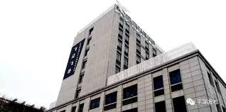
FLFX clothing company
Founded in 1995
Original Designed Manufacturer
Owns two independent brands of men's clothing, "Jack Ferre" and "Alexander".
Produces more than 30 kinds of clothing: men's shirts, jackets, down jackets, cotton-padded clothes, casual pants, etc.

Slide 18
Current issues
High level of inventory/ low inventory turnover
Order production quantity by intuition
Lack of forecasting capability
Reduced sales due to Covid
Lack of capable workforce
Solution:
Analysis the optimal production volume
Forecasting future trends of demand
Notes:
Issue:
High level of inventory => due to lack of forecasting ability => using solver linear programming (production capacity constraints(resources capacity constraints/ / productivity constraints (labor constraints/ working hour/ number of employee) => application: trendline graph, predict aggregate demand,
To better analysis the cost distribution => application: using influencing diagram.
part 1: identify the reason for high level of inventory => reason: design too many products, should suggest company to focus design top 10 best selling product => using forecasting method to identify the top 10 products
part 2: based on previous sales data => calculate the optimal production quantity for the 10 products (eg: like F1 race example)
Concept to use: Index, match, lookup, trendline, normal distribution, rand, rand between

Slide 19
Application on lecture concept
Analysis the optimal production volume
List out all the resources available
Set the constraints
Solve for optimal solution using solver
Forecasting future trends
Use historical data to estimate growth rate
Built a multifactor model
Draw regression line for each factor considered

